Slide 1

CSC432 – information Security
Dr. Adnan Ahmad

Slide 2
Authentication & authorization

Slide 3
Goals of security
Prevention
How to prevent an attack
Detection
How to detect an attack
Recover
How to recover from an attack

Slide 4
Authentication vs. Authorization
Authentication
Who are you
Passwords
Authorization
What you can do
Access control

Slide 5
Passwords
Confirms an entity’s identity
Various approaches
Something you know
passwords
Something you have
University ID cards
ATM cards
Something you are
Fingerprints
Face recognition
Voice recognition
Retina recognition
Examples ?
Also use in combinations…

Slide 6
Passwords
What is a Password?
Combination of characters (available from keyboard)
Should be secure and easy to use
Passphrase: sequence of words or text
Spaces allowed
Usually longer than password

Slide 7
Passwords
Problems With Passwords
Attacker may see the password when it is used
Attacker may read the file where computer stores password
Your password might be easy to guess at your computer
Your password might be crack-able offline (brute force)
Your password might be secure, but the system may become too inconvenient to use (e.g. very long password)

Slide 8
Passwords
Online Password Guessing
Try to guess the password while system in use
Attacker has only a limited time
Guesses can be recorded/tracked
Security depends on:
Number of incorrect guesses allowed
Consequence of too many incorrect guesses
Approaches to make system more secure:
Lock system (e.g. account) if too many guesses
Limit the speed that guesses can be made
Try to find the attacker
Make passwords harder to guess

Slide 9
Passwords
Offline Password Guessing
Try to guess the password outside of normal operation of system
Attacker has no restrictions on time or computing resources
Guesses are not recorded
Passwords are stored on system
Store cryptographic hash of password
Limit read-access to password file/database

Slide 10
Attacks on password system
Dictionary attack
Guessing of password by repeated trial and error.
26 combination ?
26^{length}
Counter Guessing
Proactive password checker
Rejects easy passwords
Rejects re-used passwords
Implements password aging

Slide 11
Passwords
The best way to explain how to choose a good password is to explain how they're broken

Slide 12
Passwords
Generally, the attacks on passwords are based on a model known as an offline password-guessing attack
The attacker gets a file of encrypted passwords
Turn that encrypted file into unencrypted passwords, by guessing passwords, and then seeing if they're correct
Yes, there are ways to foil this attack, and that's why we can still have four-digit PINs on ATM cards, but it's the correct model for breaking passwords
There are commercial programs (hacker tools) that do password cracking, and they're really good

Slide 13
Passwords
The efficiency of password cracking depends on two largely independent things: power and efficiency
Power (computing power) means powerful computers, test more passwords per second
one program advertises eight million per second
Efficiency, on the other hand, is the ability to guess passwords cleverly
Try the most common passwords first
It doesn't make sense to run through every eight-letter combination (200 billion possible passwords) from "aaaaaaaa" to "zzzzzzzz“, in order

Slide 14
Passwords
Typically passwords consists of a root plus an appendage
Root not necessarily a dictionary word, but usually something pronounceable
An appendage is either a suffix (90% of the time) or a prefix (10% of the time)
Examples of root, "letmein" "temp" "123456“
Examples of suffix appendages, "1" "4u" “2014" “007" "!"

Slide 15
Passwords
Password cracking programs use different dictionaries
English words, names, foreign words, phonetic patterns and so on for roots
Two digits, dates, postal codes, single symbols and so on for appendages
They run the dictionaries with various capitalizations and common substitutions: "$" for "s", "@" for "a," "1" for "l" and so on
Modern password crackers combine different words from their dictionaries
They can be fed with any personal information about the password creator
They can test names and addresses from the address book, meaningful dates, and any other personal information
If you ever saved an e-mail with your password, or kept it in an obscure file somewhere, or if your program ever stored it in memory, they can grab it

Slide 16
Passwords
There are schemes for generating passwords, e.g. string together individual words like "correcthorsebatterystaple“
No longer good practice (password crackers are on to this trick)
Last year, Ars Technica gave three experts a 16,000-entry encrypted password file, and asked them to break as many as possible
The winner got 90% of them, the loser 62%
It's the same sort of thing we saw in 2012, 2007, and earlier
If there's any new news, it's that this kind of thing is getting easier faster than people think
Pretty much anything that can be remembered can be cracked

Slide 17
Passwords
So, what’s the solution, how to create a strong (secure) password?
Define your own scheme
“So if you want your password to be hard to guess, you should choose something that this process will miss. My advice is to take a sentence and turn it into a password. Something like "This little piggy went to market" might become "tlpWENT2m". That nine-character password won't be in anyone's dictionary. Of course, don't use this one, because I've written about it. Choose your own sentence, ‘something personal’.”
"Schneier scheme"

Slide 18
Passwords
Here are some examples:
WIw7,mstmstootc = When I was seven, my sister threw my stuffed teddy out of the car
Wow,doestcst = Wow, does that couch smell terrible
Ltime@go-inag~faaa! = Long time ago in a galaxy not far away at all
uTVM,TPw55:utvm,tpwstillsecure = Until this very moment, these passwords were still secure
The idea is to combine a personally memorable sentence with some personally memorable tricks to modify that sentence into a password
Even better is to use random unmemorable alphanumeric passwords

Slide 19
Passwords
There's more to passwords than simply choosing a good one:
Never reuse a password you care about
Even if you choose a secure password, the site it's for could leak it because of its own incompetence
You don't want someone who gets your password for one application or site to be able to use it for another
Don't bother updating your password regularly
The requirement 90-day (or whatever) password upgrades do more harm than good
Unless you think your password might be compromised, don't change it
Beware the "secret question“
This backup system is easier to break than your password
Never write your passwords on a piece of paper and secure that piece of paper

Slide 20
Authorization
What can someone do?
Function of specifying access rights to resources
The system uses this to decide
whether access requests from (authenticated) consumers shall be approved (granted) or disapproved (rejected).

Slide 21
Important Terms
Policy
high-level requirements that specifies
how access is managed
who may access
what information
A statement of what is, and what is not, allowed
Model
provides a formal representation of the access control policy and its working.
Mechanism
defines the low level (software and hardware) functions
implement the controls imposed by the policy and formally stated in the model.
Models bridge the wide gap in abstraction between policy and mechanism.

Slide 22
Lampson 1969
Emergence of multiuser environment
people realized the need to prevent interference from each other
So, a model was developed
associates users with identities and
assigns permissions over system resources based on those identities.
That earliest model in 1969,
introduced the formal notions of subjects
and objects,
and an access control matrix to hold the access permission.

Slide 23
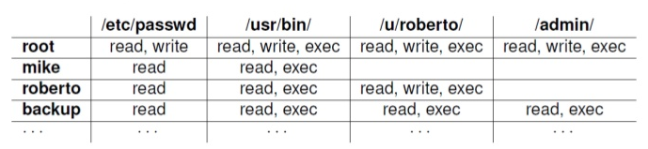
Lampson 1969

Slide 24
Bell-LaPadula model 1973
Formulated the military rules for military security applications into a mathematical model.
military security form a hierarchy
higher rank documents are only accessible to higher rank officials
The model introduced the multilevel secure system.
Users are only allowed to access information which is classified as lower than their own security clearance.
This way confidential information is restricted only to the higher ranked officials.

Slide 25
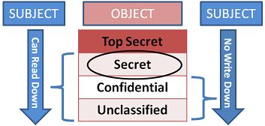
Bell-LaPadula model 1973

Slide 26
Biba’s integrity model 1977
BLP was designed for the confidentiality of the data
does nothing for integrity.
To bridge this gap, Biba’s integrity model was introduced.
The Biba model allows a subject to read an object, if the object has greater security level than the subject.
The model further extends that a subject can only write to an object if the security level of the subject is higher than the object.
In general, an object can only be written from the higher levels and read from the lower levels.
It was not an alternative to Bell-LaPadula but can act as an adjunct to it.

Slide 27
DoD models 1985
United States Department of Defense (DoD) published its own standards for military and personal applications, commonly known as
MAC (mandatory access control)
one administrator who controls every system resource and manages its access for all the users in the system.
DAC (discretionary access control)
support ownership, local control and other requirements of personal applications.

Slide 28
Clark Wilson model 1987
There are two central concepts in their model,
well-formed transaction
constraints the user to modify data only in authorized way
separation of duty (SoD)
ensures that every critical operation must be completed by at least two users.

Slide 29
Chinese wall policy 1989
Brewer and Nash model
Distributes objects in company wise dataset
and categorized them into conflict of interest (COI) circles.
A subject can read an object if
If the object belongs to the same dataset from which the subject has previously read
if the subject had not read some other object from the same conflict of interest circle.

Slide 30
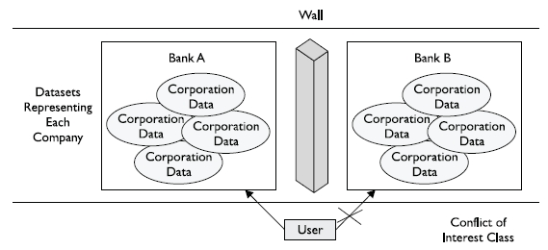
Chinese wall policy

Slide 31
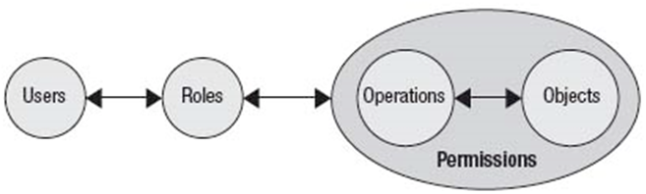
Role based access control 1992
system wide roles
which were assigned permissions over resources.
In order to access a resource,
the user needs to be a part of some role and
that role must have access rights over the requested resource.

Slide 32
Rule based access control
supports the context
In banking system
access decisions at day should be different than the same decisions at night,
In military applications
some decision at war may be completely different than the same decision during peace times.
To handle such cases, Rule base access control was introduced to support the context in access control decisions

Slide 33
dRBAC
Introduced when the software systems were extended to cross domains
Agreement of all the companies over rights associated to some role existing in multiple domains.
Also, the working rights of one role of one company are restricted to its domain only, which makes the situation more complex.
The solution to these problems is given by distributed role based access control (dRBAC) by maintaining separate system domains for each company in the collation.

Slide 34
Evolution of access control
Application | Requirements | Model
Mainframe computers | Time sharing, Prevent users from interfering | Lampson
Military applications | Users’ clearance, Multilevel security | Bell-LaPadula
Military applications | Hierarchy of users, confidentiality, secure system state, Admin control | MAC
Personal applications | Ownership, No administrator, user control | DAC
Commercial applications | Integrity, Separation of duties, well-formed transaction | Clark Wilson
Commercial and government organizations | System wide roles, complexity, user overhead, organizational structures | RBAC
Organizations | Context aware, situation based | Rule based
Collation environment | Security and availability in overlapping domains | dRBAC

Slide 35
THANKS

